Slide 1

Sprocket Central Pty Ltd
Data analytics approach
AMIT KADARMANDALGI

Slide 2
Note: The data and information in this document is reflective of a hypothetical situation and client. This document is to be used for KPMG Virtual Internship purposes only.
Agenda
Introduction
Data Exploration
Model Development
Interpretation

Slide 3

Introduction
Presentation is Divided into 3 main phases
Data Exploration
Data Modelling
Interpretation
Place any supporting images, graphs, data or extra text here.

Slide 4
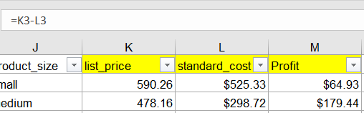
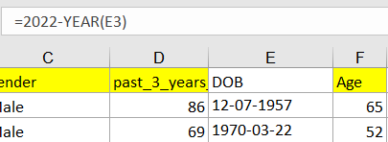
Note: The data and information in this document is reflective of a hypothetical situation and client. This document is to be used for KPMG Virtual Internship purposes only.
Data Exploration
Data Cleaning and consistency check
Correcting data types
Created a model data set
Making sure there are no duplicates and constituency in data
Converted product first sold date into date format
b. Feature Engineering: New Variable creation
Age using DOB
Finding Profit using List price – Selling Price
Using pivot table to get frequency for variables like owns a car, gender, wealth segment
Understanding rank column exploring hidden columns and formulae

Slide 5
Note: The data and information in this document is reflective of a hypothetical situation and client. This document is to be used for KPMG Virtual Internship purposes only.
Data Exploration
Data Distribution
Created Visual histograms to check distributions on various variables such as Age which is highest in 30 to 80 peaking at 50 to 70 age bracket and Bike purchase is evenly distributed which gives no insight and property evaluation is mainly 7 -11.
Pie chart for showcasing demographic dividend with respect to Gender which is more towards Females and for wealth segment mass customers are around 50 % whereas affluent and high net worth individuals together make 50 %
Corelation check to understand relation between rank and associated columns
Owns a car
Yes | 493
No | 507

Slide 6
Model Development
Merged Table – Using customer address, demography and transactions
Created a merged table using all crucial data from transactions, customer demographic and customer address
Decided on RFM matrix - Added Recency Frequency and Money Variables
Created customer segmentation based on RFM Scores
Charts for Old Customer and New Customers using Pivot Tables
Comparison of profit of old customers compared to value of new customers wrt age wise distribution in wealth segments
Cars owned in different states for old compared to new customers
Industry wise distribution of Profits of Old Customers compared to value of New Customers
Old Customer Gender wrt Profit compared to New Customer Gender wrt Value
Old customer segmentation wrt RFM score compared to New Customer segmentation wrt Value
Count of product_id | Min of Recency | Sum of Profit | R Score | F Score | M Score | RFM Value | Customer Type
11 | 7 | 3018.09 | 4 | 4 | 3 | 443 | Platinum
R Score |  | F Score |  | M Score |  | RFM Score |  | Customer Types
Min | 0 | Min | 1 | Min | 15.08 | Min | 111 | Bronze
Lower Quartile | 17 | Lower Quartile | 4 | Lower Quartile | 1905.948 | Lower Quartile | 144 | Silver
Median | 44 | Median | 6 | Median | 2918.195 | Median | 244 | Gold
Upper Quartile | 85 | Upper Quartile | 7 | Upper Quartile | 4273.398 | Upper Quartile | 344 | Platinum
Max | 353 | Max | 14 | Max | 11668.95 | Max | 444

Slide 7
Interpretation
On Rank created for New Customer
The Rank given according to value
Value is a combination of randomized values with multipliers of different variables such as -
property value, owns a car, wealth segment, past 3 year cycle purchase
Corelation and Distribution for New Customer list
Negligible corelation found with value and related variables mainly due to randomized inputs taken for derivation of value
Majority customers hold property valuation of 7-11
Wealth segment is mainly 50% masses rest 25 % each for affluent and high net worth individuals
Major age bracket of customers in 50-70
 | Value | past_3_years_bike_related_purchases | wealth_segment
Value | 1
past_3_years_bike_related_purchases | 0.004884 | 1
wealth_segment | 0.000254 | 0.017678243 | 1
 | Value | owns_car | property_valuation
Value | 1
owns_car | -0.02742 | 1
property_valuation | -0.0147 | -0.063631546 | 1

Slide 8
Interpretation
For both old and new customer target age group is 30 to 70 top priority is 40-50. Mass customers can not be ignored in both cases

Slide 9
Interpretation
NSW is the toughest market to sell bikes for both old and new customers must avoid the state focus must be on Victoria and Queensland

Slide 10
Interpretation
Finance Healthcare and Manufacturing are the big three most valuable industries
Both can not have a gender based strategy as there is no significant difference in targeting based on gender

Slide 11
Interpretation
Both old and New customers show striking resemblance to distribution of customer segmentation in which platinum and Gold customers must be prioritized

